Slide 1

3D COIN COLLECTOR / TREASURE HUNT GAME
CSC-317 – Computer Graphics
Khaled Hassan Ezz
Ranin Mohamed
Roqia Shehab

Slide 2
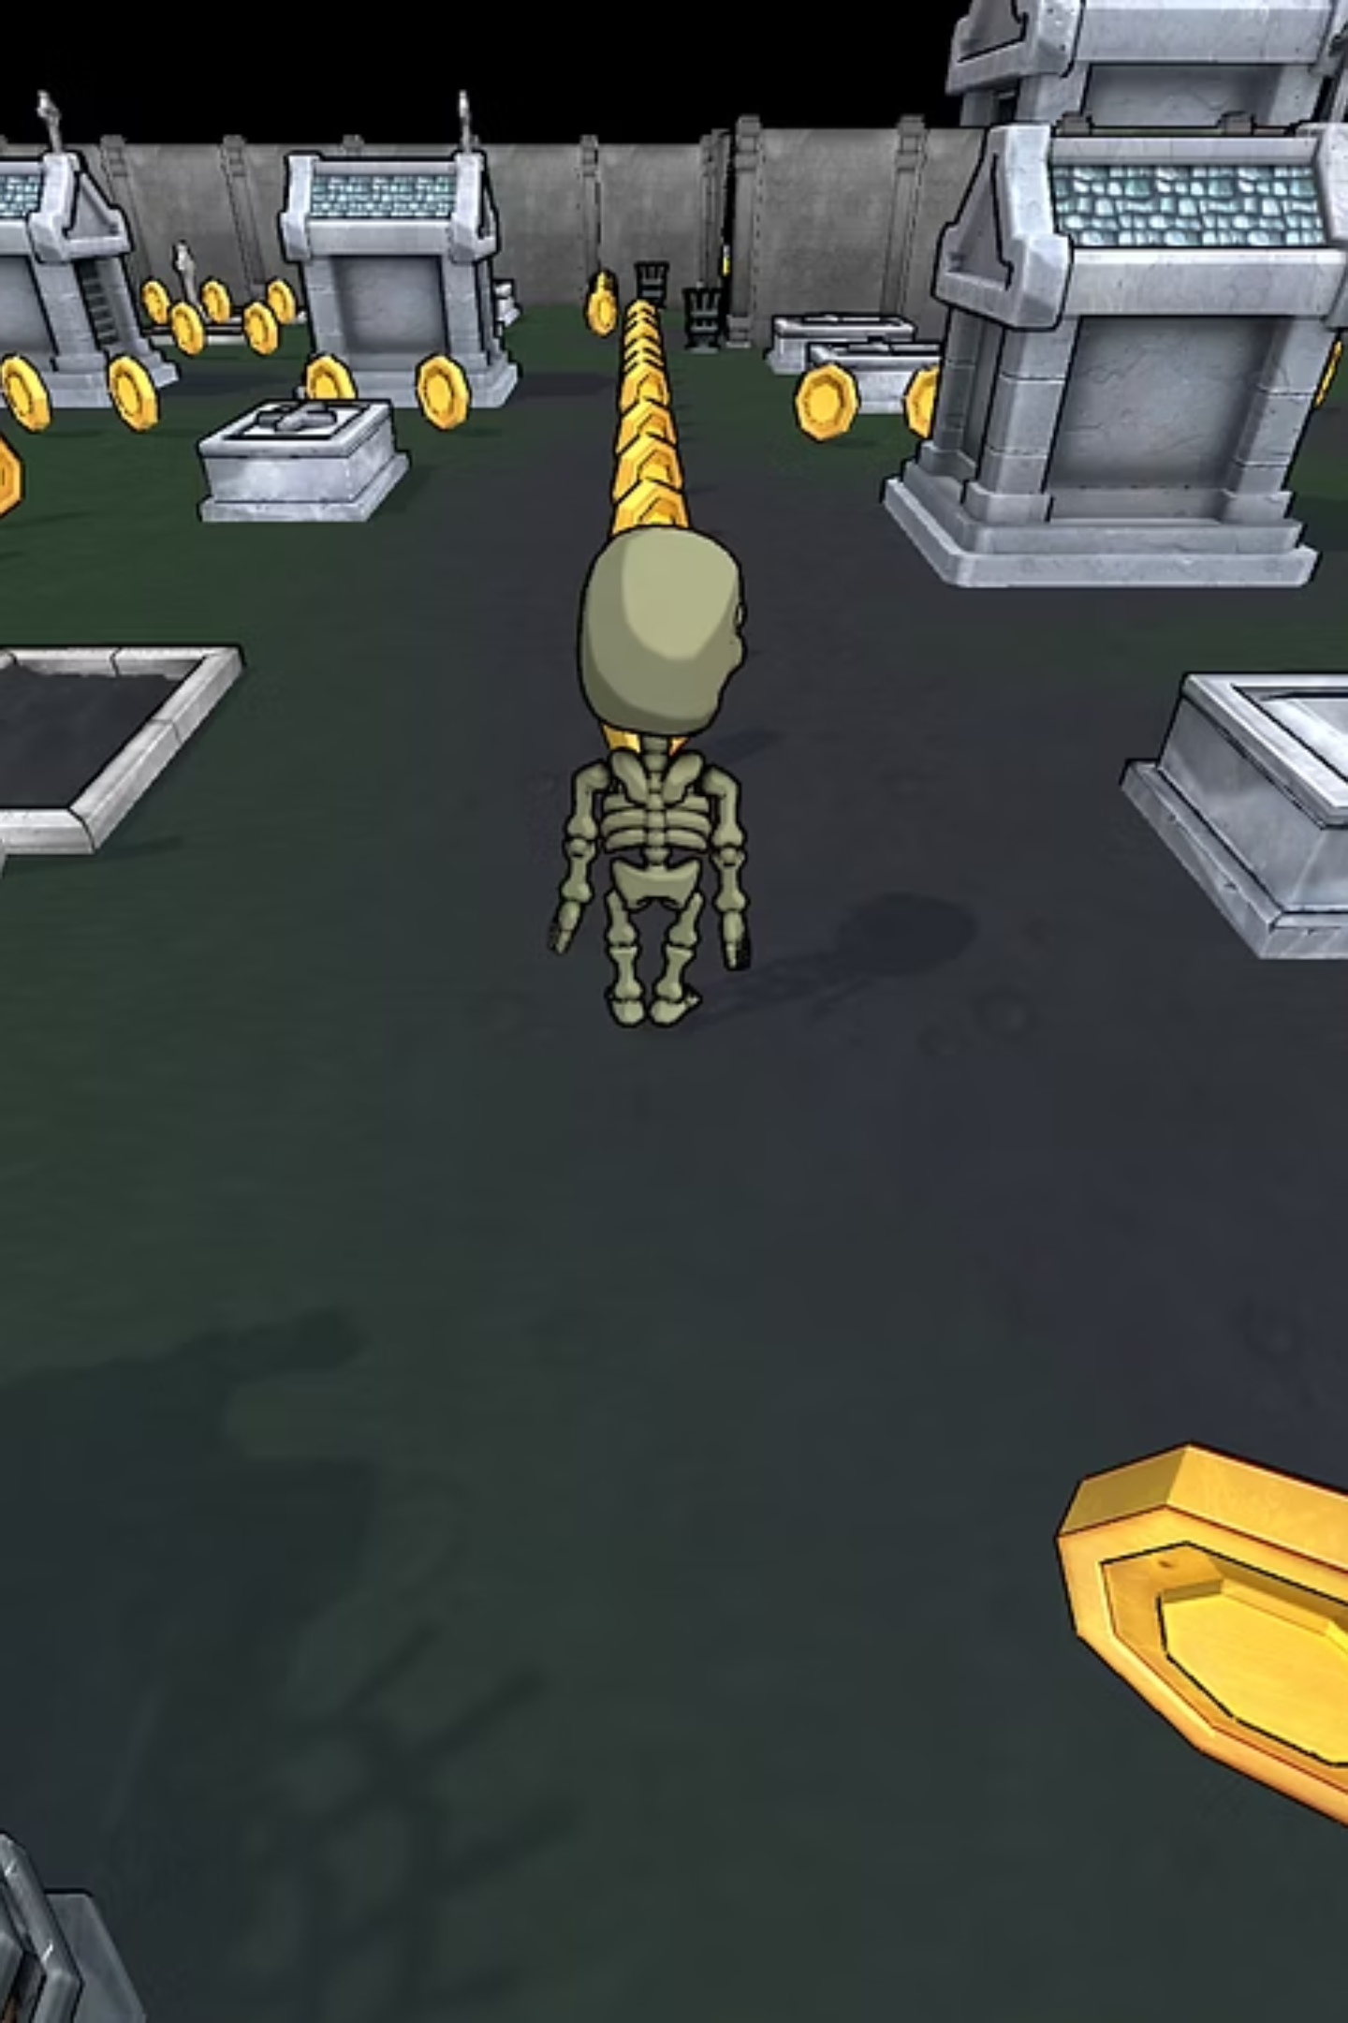
PROJECT OVERVIEW
THIRD-PERSON 3D ADVENTURE
UNITY & C# FOUNDATION
Engaging perspective for immersive gameplay.
Developed with industry-standard game engine and programming language.
CORE GAMEPLAY LOOP
Collect coins, unlock key, open gate, avoid enemies, reach checkpoint.

Slide 3

GAME OBJECTIVES
This project served as a practical learning experience, focusing on fundamental game development concepts.
MASTERING UNITY BASICS
PLAYER INTERACTION DESIGN
SIMPLE AI INTEGRATION
Developing basic enemy artificial intelligence for dynamic challenges.
Hands-on experience with the Unity editor and its core functionalities.
Implementing robust player movement and environmental interaction systems.

Slide 4

GRAPHICS TECHNIQUES USED
LIGHTING
Unity's built-in lighting system with Directional Light for realistic shadows and depth
CAMERA TRANSFORMATIONS
Third-person camera that follows player with dynamic adjustment for smooth rotation
TEXTURE MAPPING
Applied to ground, walls, coins, enemies, and characters for realism
SHADERS
Unity's standard shaders handling material properties (color, reflection, shading)
ANIMATIONS
Character animations (idle, walking, running, jumping) controlled by Animator Controller with root motion

Slide 5
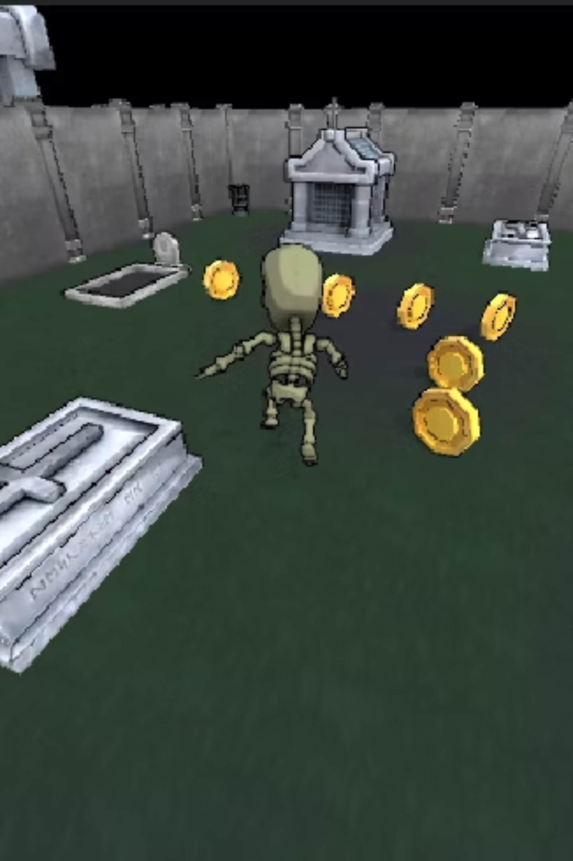
GAMEPLAY FEATURES
Player Movement: Walk, run, jump, crouch for varied navigation.
Coin Collection: Tracked score and visual feedback.
Key & Gate Mechanic: Progressive level unlocking.
Enemy Encounters: Dynamic obstacles for player avoidance.

Slide 6

PLAYER CONTROL SYSTEM
INPUT & MOVEMENT SEPARATION
Modular design for responsive and flexible controls.
THIRDPERSONUSERCONTROL
Handles player input based on user commands.
THIRDPERSONCHARACTER
Manages character physics and animation states.
RIGIDBODY & ANIMATOR
Ensures realistic movement and fluid animation transitions.

Slide 7
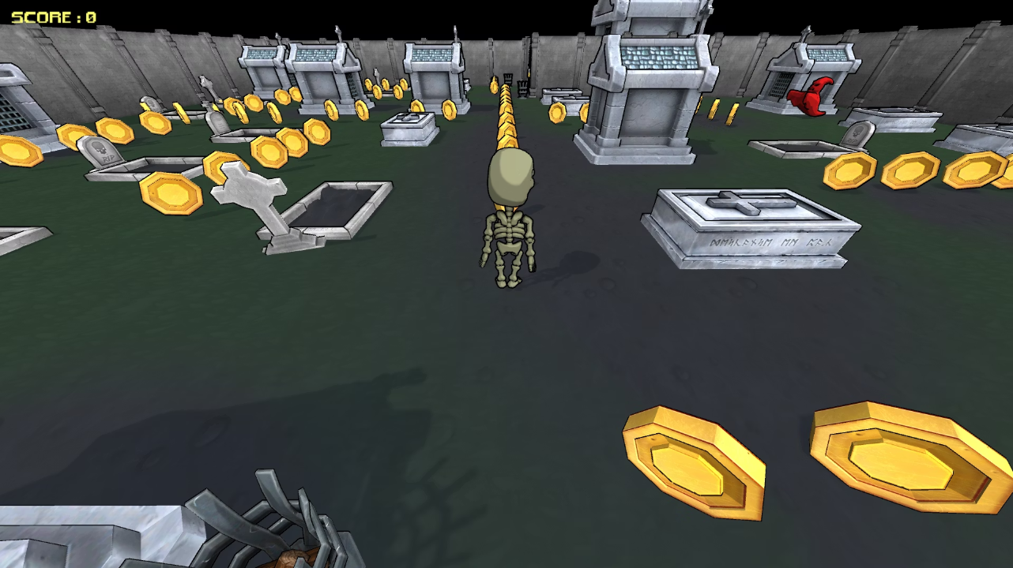
COIN COLLECTION SYSTEM
Collision Detection: Triggers collection upon player contact.
UI Score Update: Real-time feedback on collected coins.
Dynamic Coin Counting: Utilises object tags for efficient tracking.
Key Activation: Unlocks the gate upon collecting all coins.

Slide 8
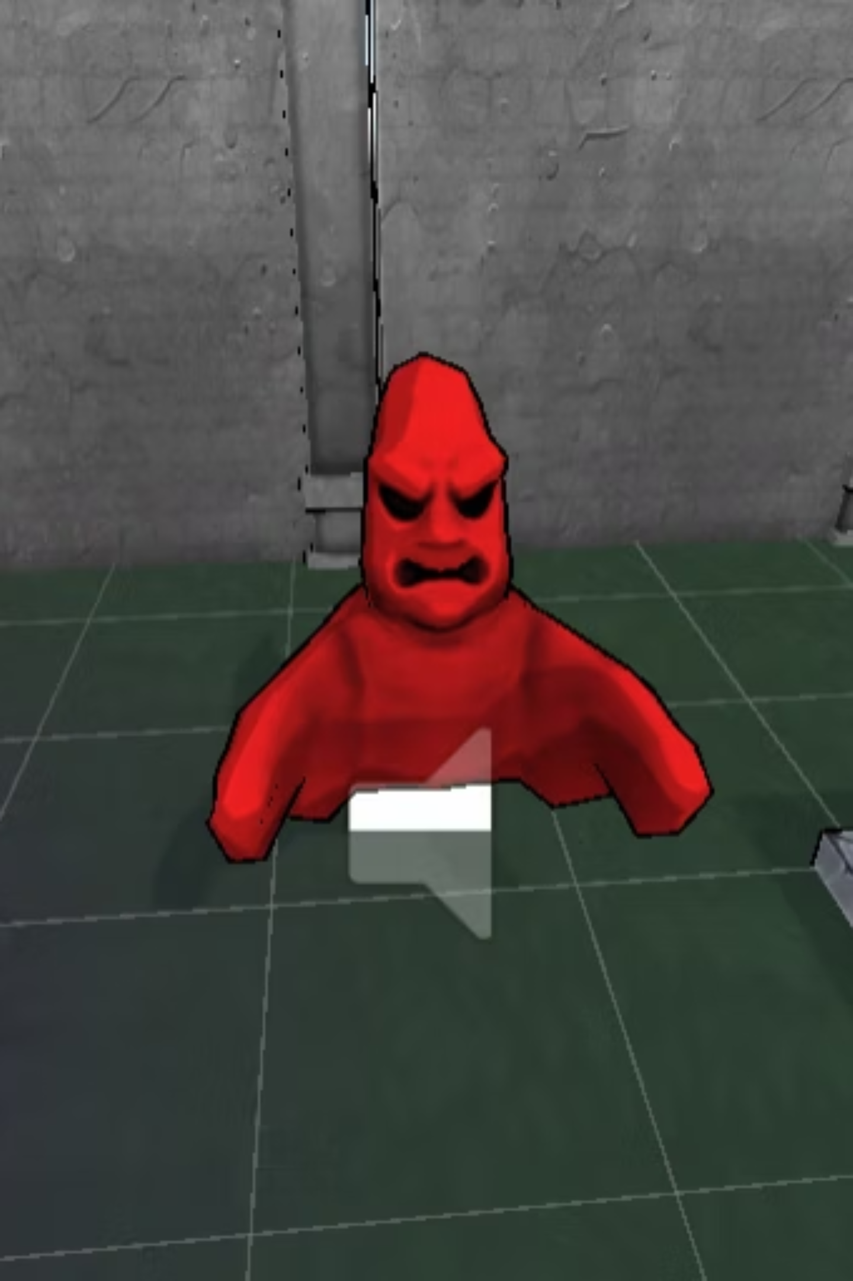

ENEMY AI SYSTEM
NAVMESHAGENT IMPLEMENTATION
Pathfinding for intelligent enemy movement.
WAYPOINT PATROL
Enemies navigate predefined routes.
GAME OVER ON COLLISION
Failure condition triggered by enemy contact.

Slide 9




GAME STATES
The game transitions between distinct states to manage flow and player experience.
GAME OVER
PLAYING
Failure condition reached, prompt for restart.
Active gameplay and interaction.
GAME PAUSED
WIN CONDITION
Time.timeScale manipulation for pause functionality.
Objective complete, player successful.

Slide 10


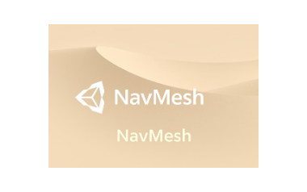



TECHNOLOGIES USED
Leveraging powerful tools for efficient and effective game development.

Slide 11

CONCLUSION & FUTURE IMPROVEMENTS
PROJECT ACHIEVEMENTS
FUTURE EXTENSIONS
Successful implementation of core gameplay mechanics.
Health System: Introduce player damage and health management.
Demonstrated proficiency in Unity and C# for 3D game development.
Additional Levels: Expand gameplay with new environments and challenges.
Foundation for more complex game projects established.
Advanced AI: Implement more sophisticated enemy behaviours and patterns.

